Slide 1
Parihara-AI
Multi-Disease Prediction Platform

Slide 2

Motive
An AI Solution for healthcare concerns
combines diverse healthcare data
early detection
risk prediction
Friendly UI/UX

Slide 3
Why Our Project ?
60%
40%
30%
Late Diagnosis
Mortality Reduction
Cost Savings
Chronic diseases in India diagnosed at advanced stages, severely limiting treatment success rates
Early detection can significantly reduce death rates through timely intervention
Healthcare costs reduced through preventive care instead of expensive late-stage treatments

Slide 4
What we focused ?
System Interoperability
Designed for seamless integration with existing hospital information systems and popular mobile health platforms across India
Robust Data Handling
Helps users with easy accessibility, non-complex architecture and easy diagnosis regardless of any age group
Privacy-First Architecture
Fully compliant with Indian data protection laws and ethical AI guidelines, ensuring patient confidentiality, easily adaptable and usable

Slide 5
What we have built !
A smart healthcare platform that combines patient data to detect disease risks early and support timely intervention.
We built an AI-powered system that:
- Combines multiple health inputs - Analyses them together - Predicts disease risk early
Goal:
Move from treatment to prevention

Slide 6
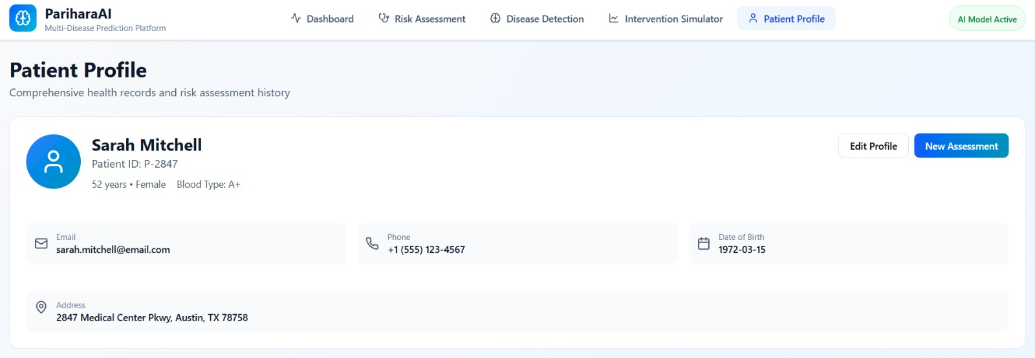
What data we use ?
The system takes:
• Basic patient info • Medical history • Symptoms • Lifestyle factors • Vitals
Instead of looking at one parameter, AI studies overall health patterns

Slide 7
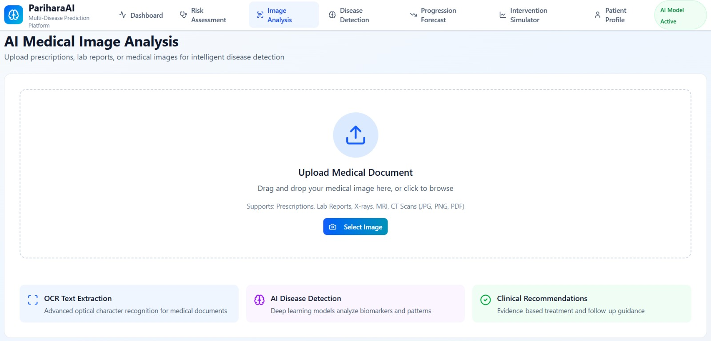

Slide 8
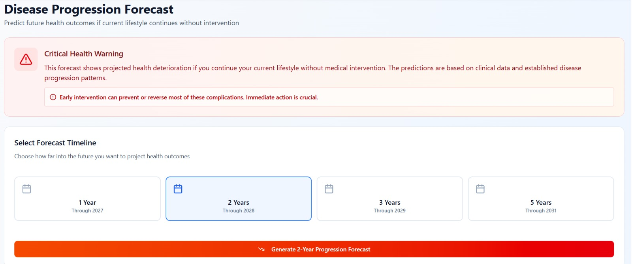

Slide 9
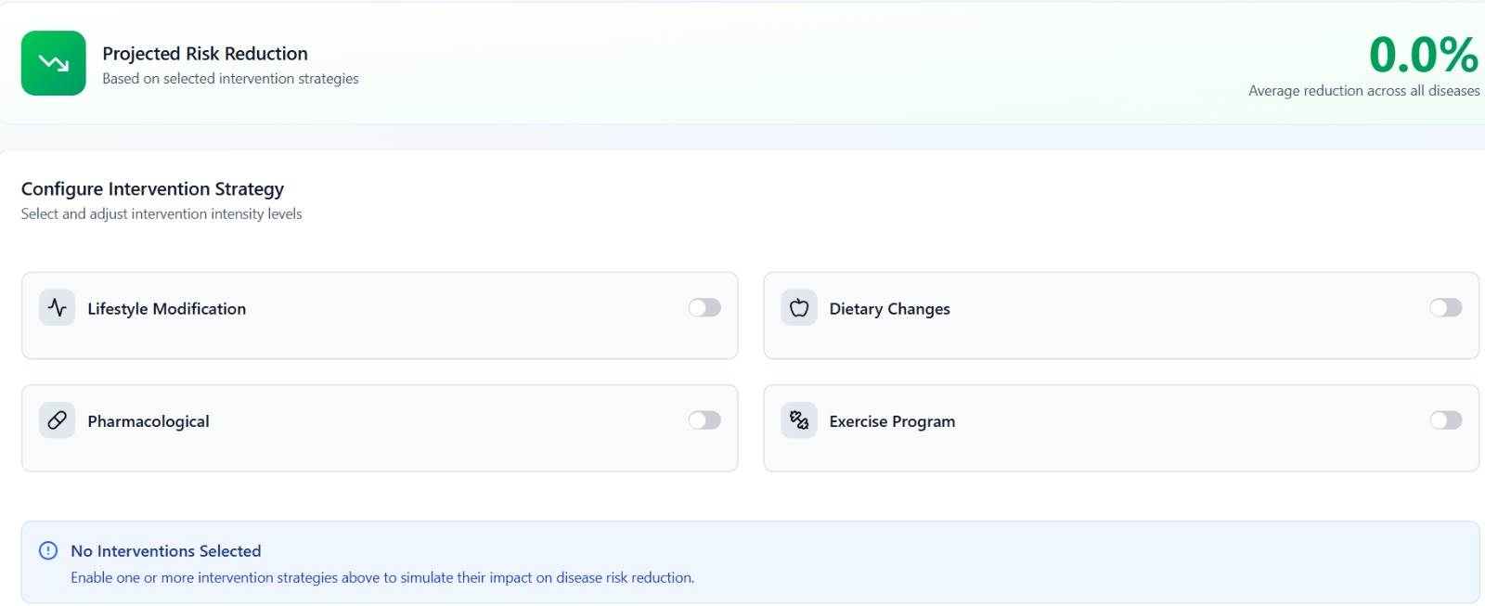

Slide 10
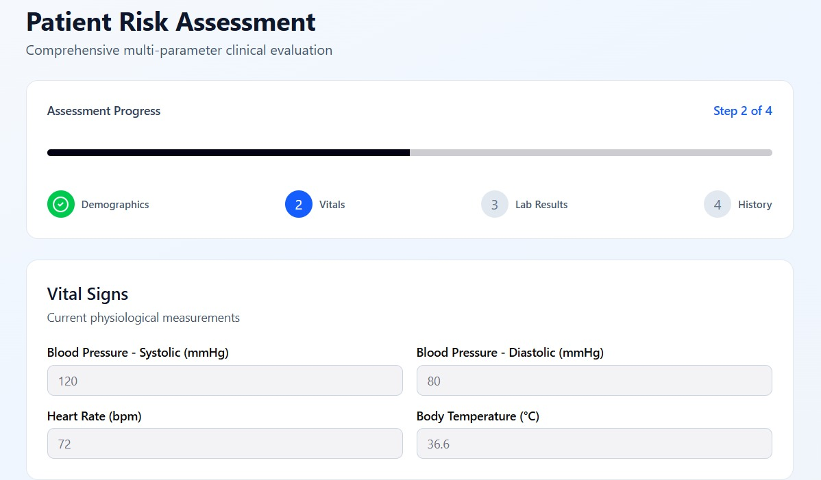
HOW IT WORKS
Step 1 → User enters health details Step 2 → Data is cleaned & processed Step 3 → AI model analyses patterns Step 4 → Risk score is generated

Slide 11
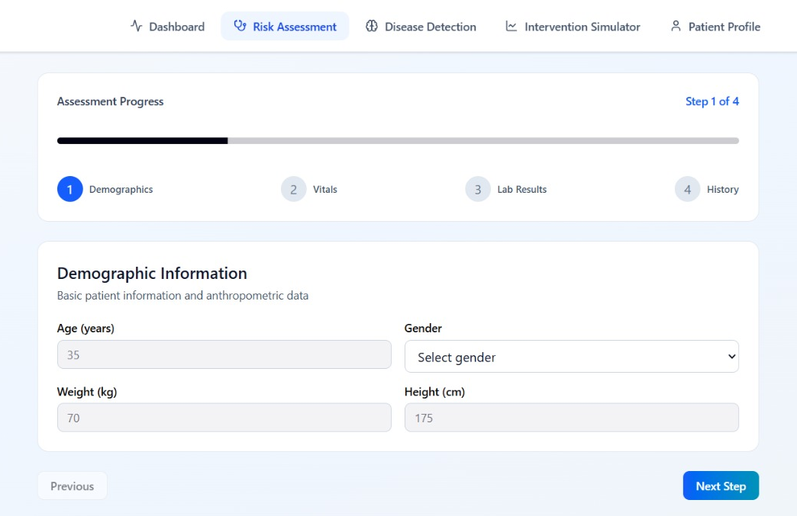
SYSTEM FLOW
User Data ↓ AI Engine ↓ Pattern Detection ↓ Risk Assessment ↓ Preventive Insight

Slide 12
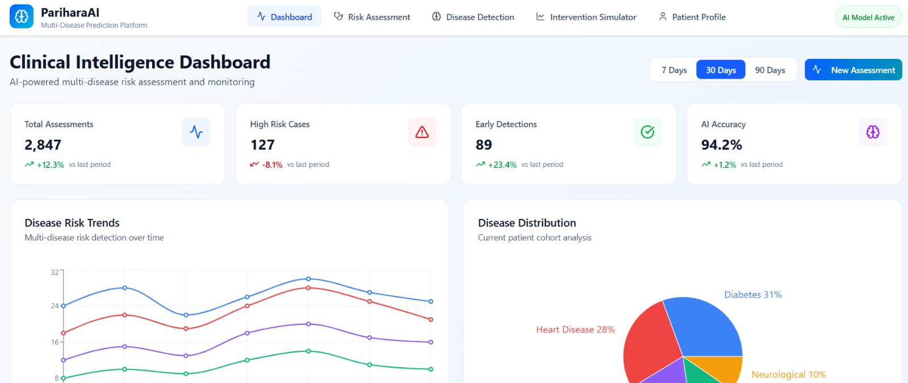
KEY FEATURES
- Early risk prediction - Personalized analysis - Fast processing -Preventive insight -Easy-to-use interface

Slide 13
Early detection helps: • Avoid complications • Reduce treatment cost • Improve recovery chances Doctors get: Decision support Not replacement
WHY THIS MATTERS?

Slide 14
IMPACT OF THE SYSTEM
-> For Patients
✔ Identifies health risks early
✔ Encourages preventive action ✔ Reduces chances of severe disease progression ✔ Promotes awareness of hidden risk factors
-> For Doctors
✔ Acts as a clinical support tool ✔ Helps in faster initial screening ✔ Assists in identifying high-risk patients ✔ Supports data-driven decision making
-> For Healthcare System
✔ Promotes preventive healthcare ✔ Reduces hospital burden ✔ Minimizes late-stage treatments ✔ Supports scalable digital health solutions
-> Overall Impact
Shifts healthcare approach from Treating diseases late to Preventing diseases early !

Slide 15
Many health apps: ❌ Track data ❌ Show reports ❌ Monitor fitness But they do NOT predict risk using combined health patterns Our System is Different Because: ✔ Analyses multiple health factors together ✔ Focuses on early risk prediction (not just monitoring) ✔ Provides preventive insight — not just data display ✔ Detects hidden patterns, not visible symptoms
WHAT MAKES OUR PROJECT UNIQUE?

Slide 16
Thank you. project by:
Karthick R
Faith Aby
Yallappa
From: Christian Institute of Management

